Slide 1


Analysis of Top 5 Popular Categories
A Data-Driven Approach to Identifying Key Trends
Presented By-
Neha Umashankar

Slide 2


Today's agenda
Project Recap
Problem Statement
Team Introduction
Analysis Process
Findings: Top 5 Popular Categories
Summary

Slide 3

Social Buzz is a top growing technology unicorn that need to adapt quickly to it's global scale.
Accenture has begun a 3 month POC focusing on these tasks:
-An audit of Social Buzz's big data practices
-Recommendations for a successful IPO
-Analysis to find Social Buzz's top 5 most popular categories of content
Project Recap

Slide 4

Problem
Over 1000000 Posts per day
36500000 pieces of content per year!
But how to capitalize on it when there is so much?
Analysis to find social buzz'as top 5 most popular categories of content ecisions

Slide 5



Andrew Fleming
Chief Technology Architect
The Analytics team
Marcus Rompton
Senior Principal
Neha Umashankar
Data Analyst

Slide 6
Process
1
Data Understanding
2
Data Cleaning
3
Data Modelling
4
Data Analysis
5
Uncover Insights

Slide 7

Insights

Slide 8
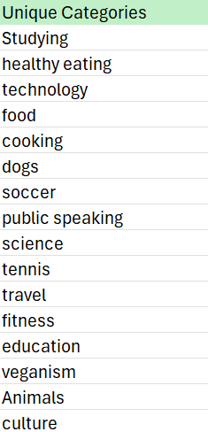
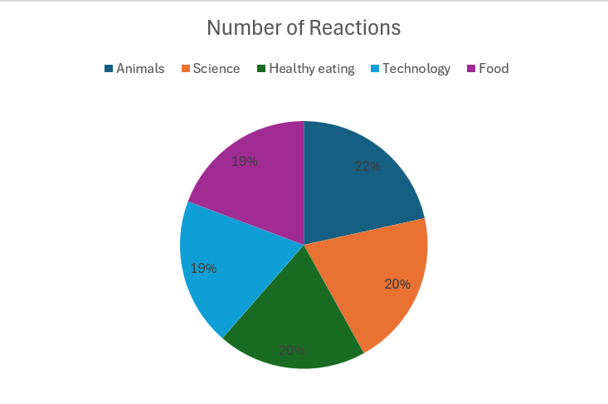
16 Unique Categories

Slide 9
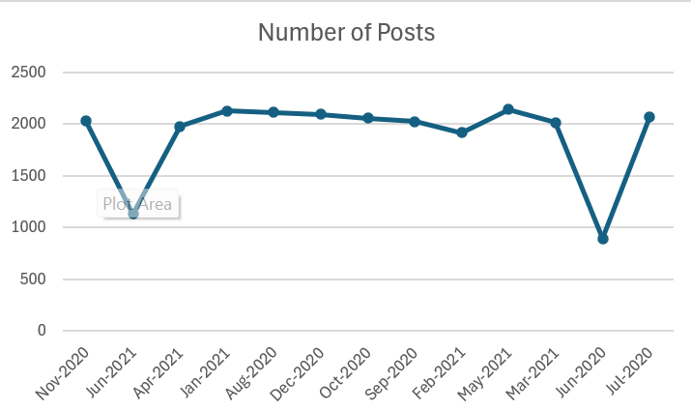


Slide 10

ANALYSIS
Animals and Science are two most popular categories of content, showing that people enjoy "real-life" and "factual" content the most.
INSIGHT
Food is a common theme with the top 5 categories with "Healthy Eating" ranking the highest. This may give an indication to the audience within your user base. You could use this insight to create a campaign and work with healthy eating brands to boost user engagement.
NEXT STEPS:
This ad-hoc analysis is insightful, but it's time to take this analysis into large scale production for real-time understanding for your business. We can show you how to do this.
Summary

Slide 11
Thank you!
ANY QUESTIONS?

